Slide 1
Finding the Subnet, Broadcast and Useable Host Ranges
Lecture 11
Topic: Transport layer protocols: Process to process delivery, addressing
Multiplexing and demultiplexing, connectionless versus connection-oriented service, Three-way handshake protocol

Slide 2
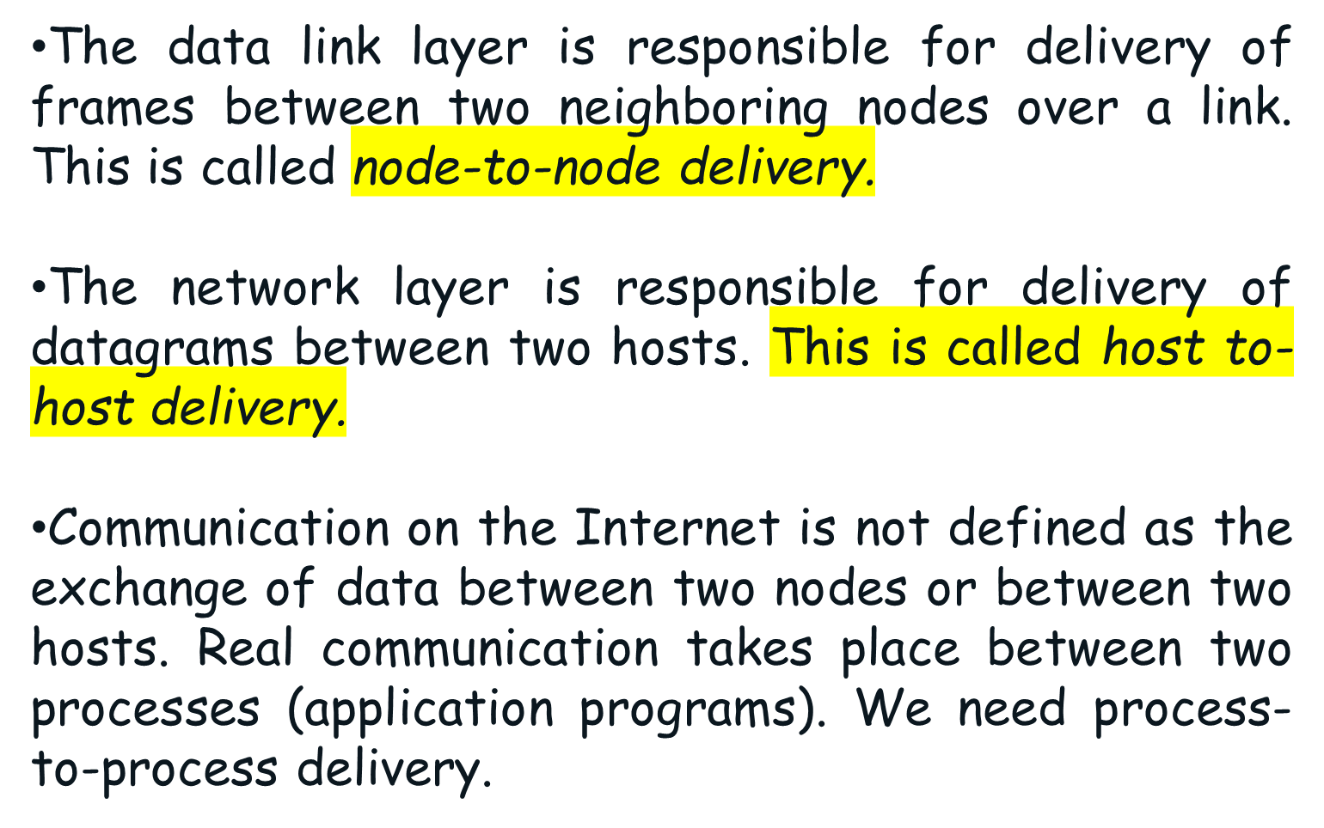
Introduction

Slide 3
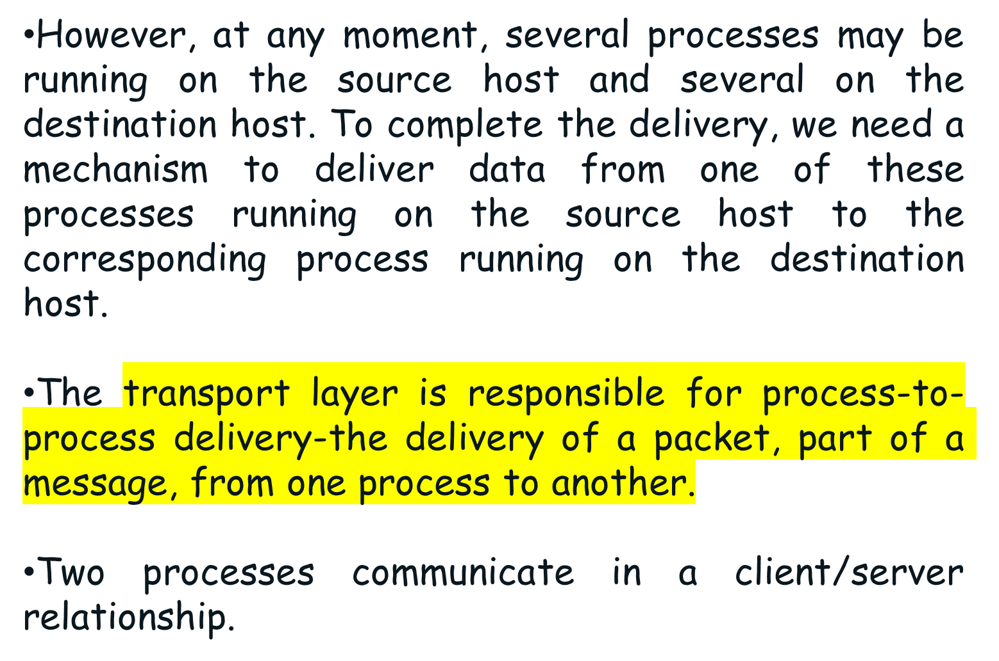
Cont.

Slide 4
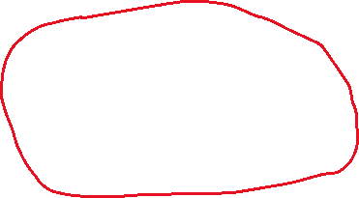


Slide 5
Client-Sever Paradigm
Although there are several ways to achieve process-to-process communication, the most common one is through the client/server paradigm.
A process on the local host, called a client, needs services from a process usually on the remote host, called a server.
Both processes (client and server) have the same name. For example, to get the day and time from a remote machine, we need a Daytime client process running on the local host and a Daytime server process running on a remote machine.

Slide 6
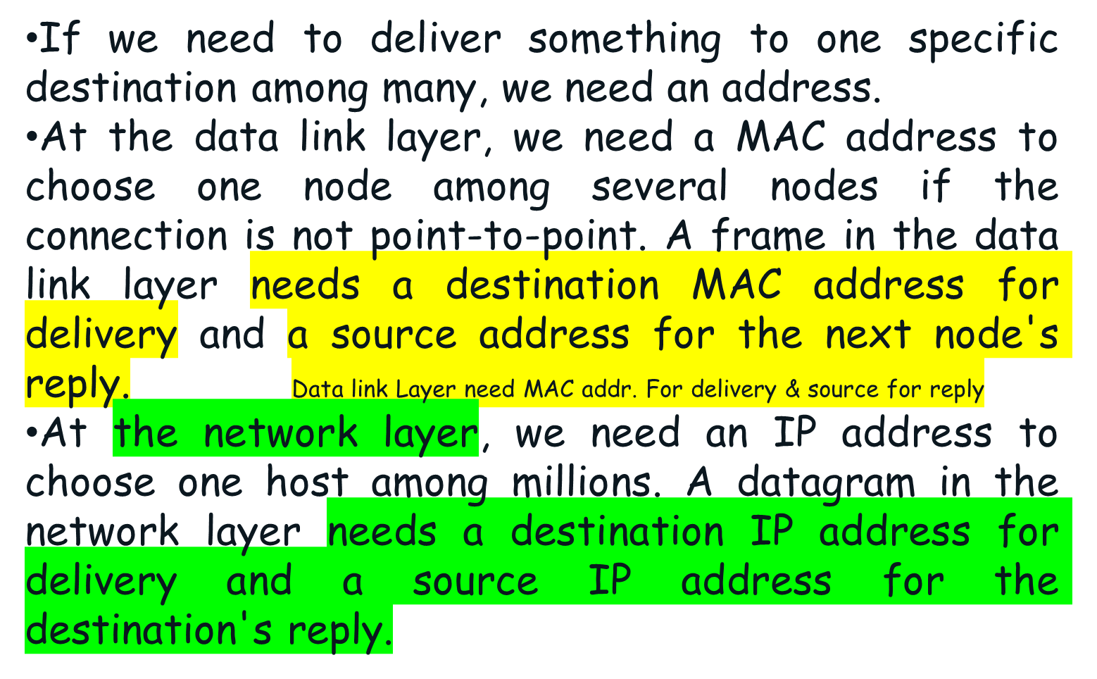
Cont.

Slide 7
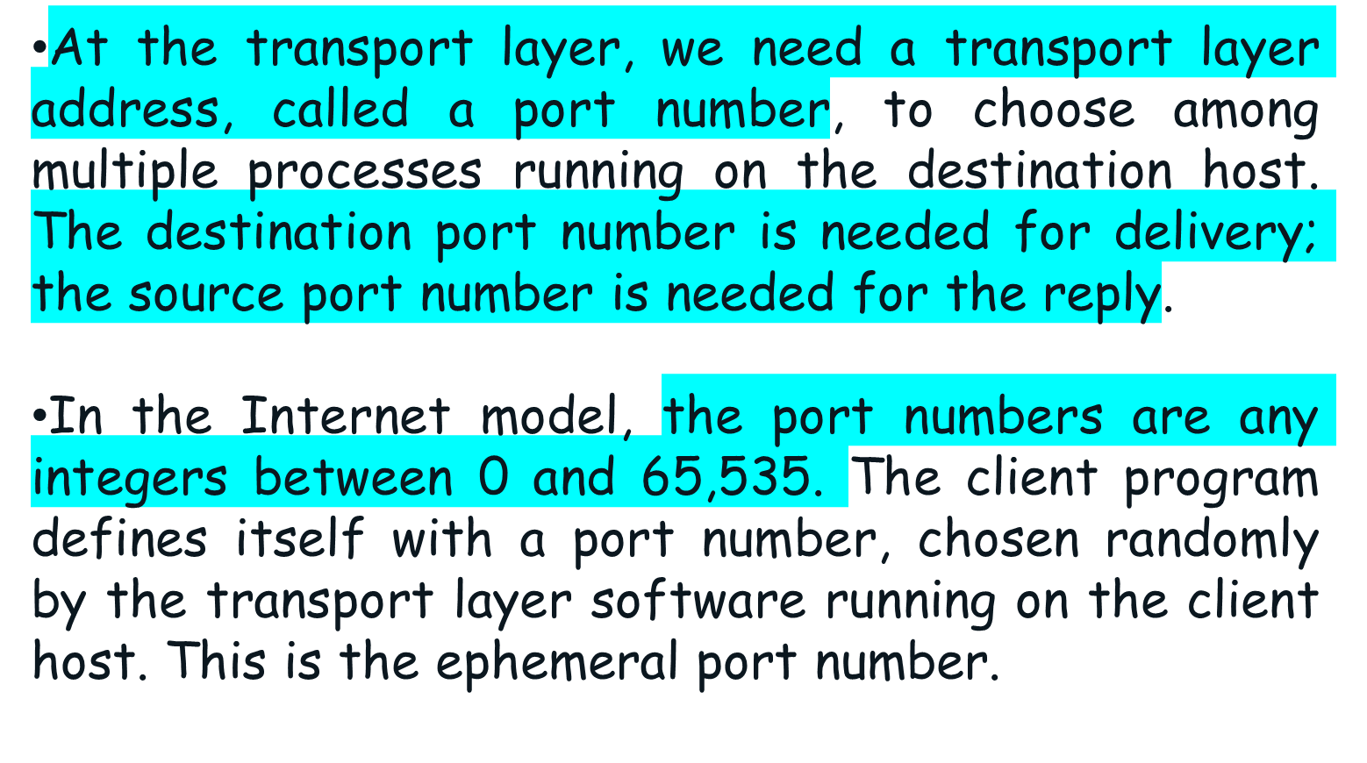
Cont.

Slide 8
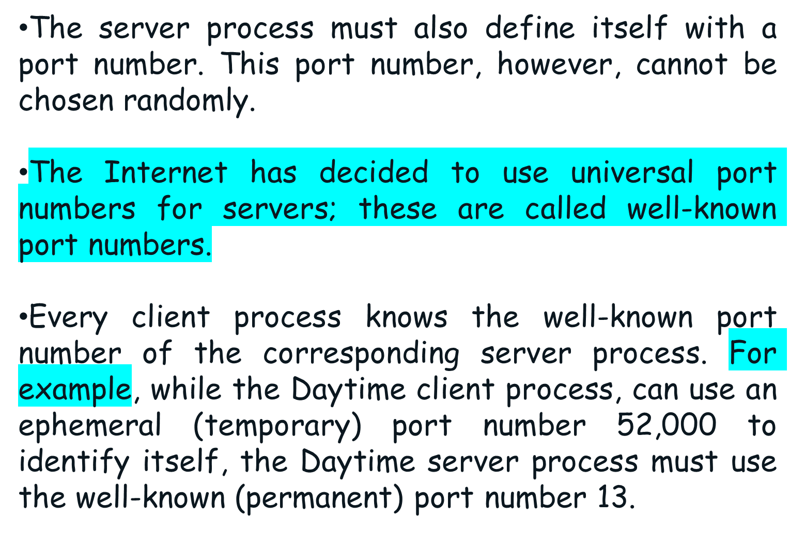
Cont.

Slide 9

Cont.

Slide 10

Cont.
It should be clear by now that the IP addresses and port numbers play different roles in selecting the final destination of data. The destination IP address defines the host among the different hosts in the world. After the host has been selected, the port number defines one of the processes on this particular host.

Slide 11
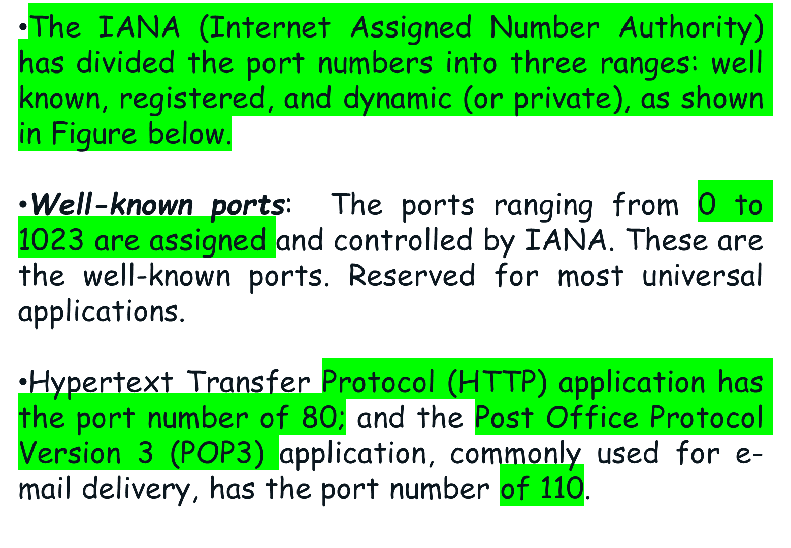
IANA Ranges

Slide 12
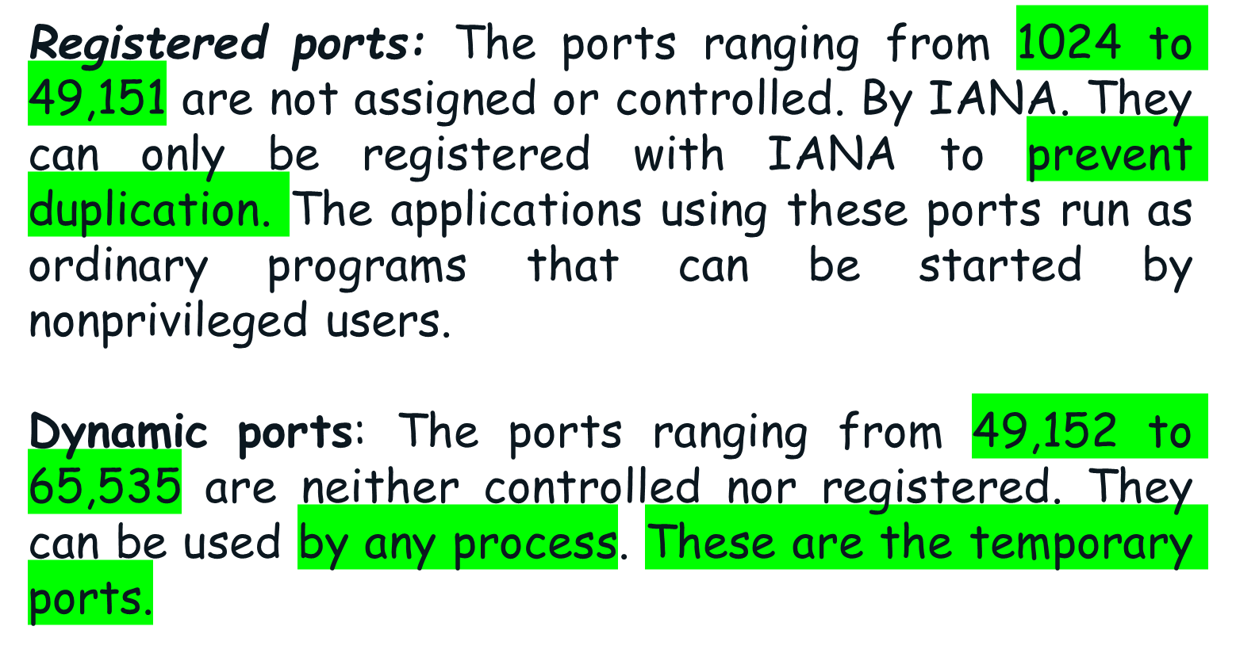

Cont.

Slide 13
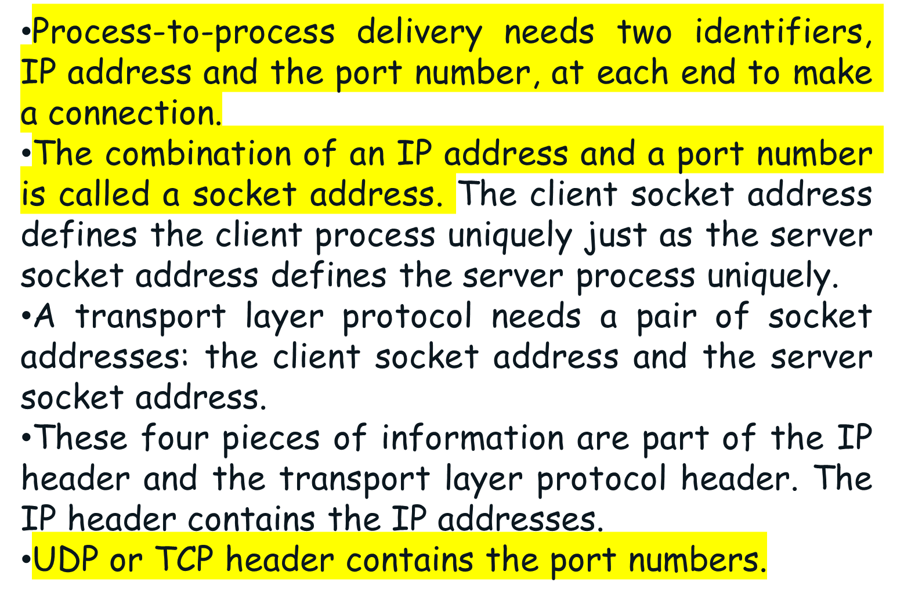

Slide 14


Slide 15
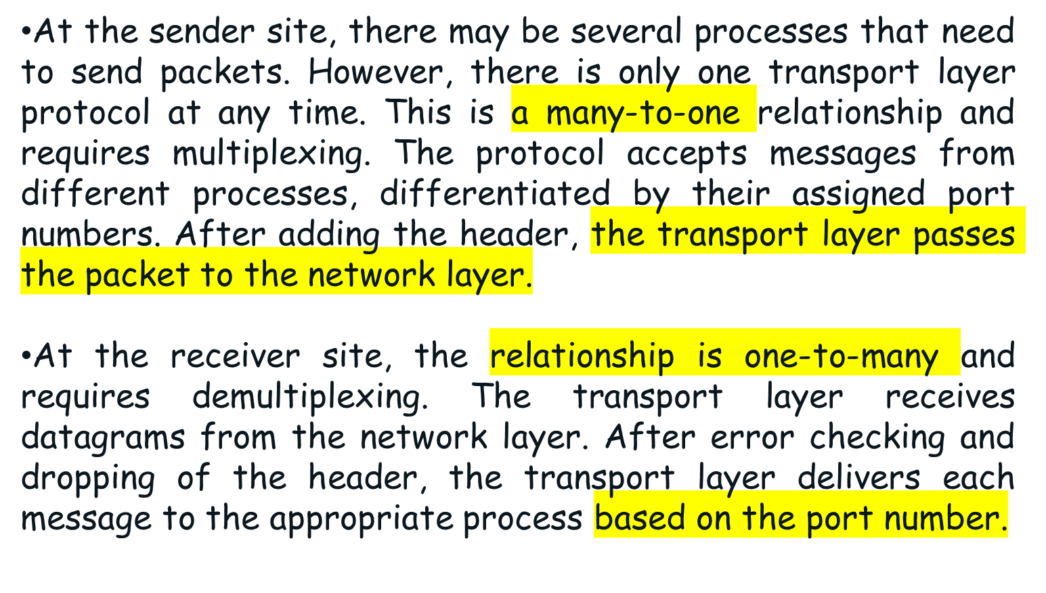

Slide 16
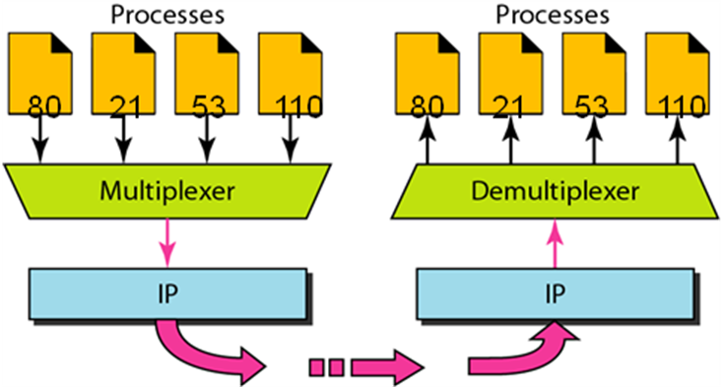

Slide 17
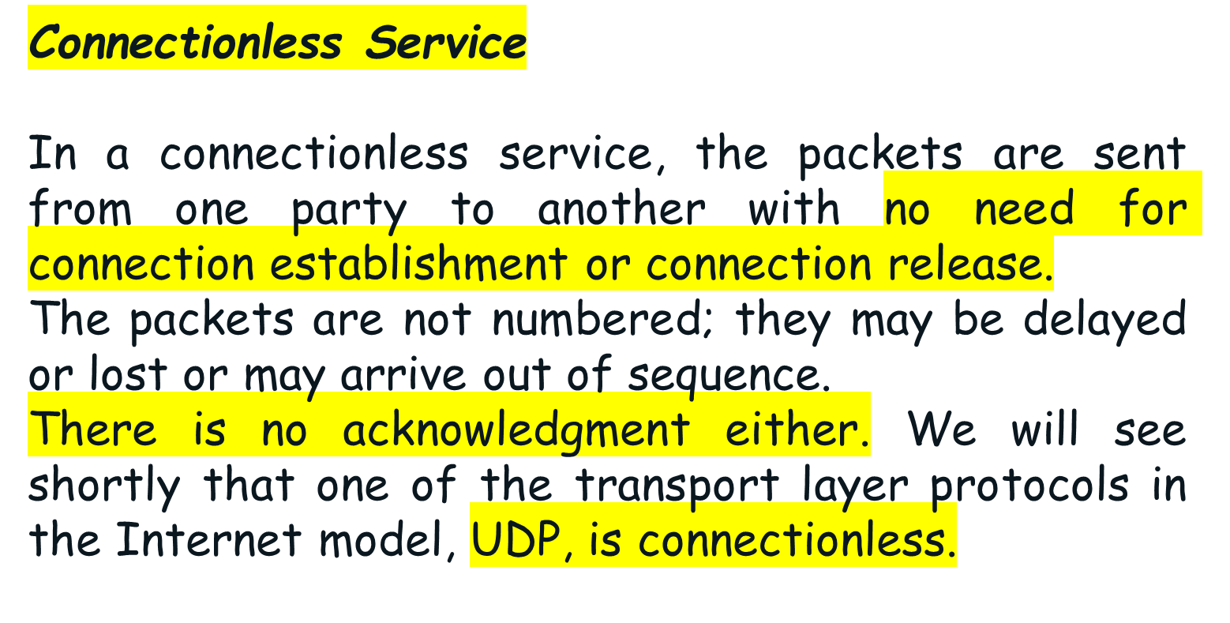
Connectionless Versus Connection-Oriented Service

Slide 18
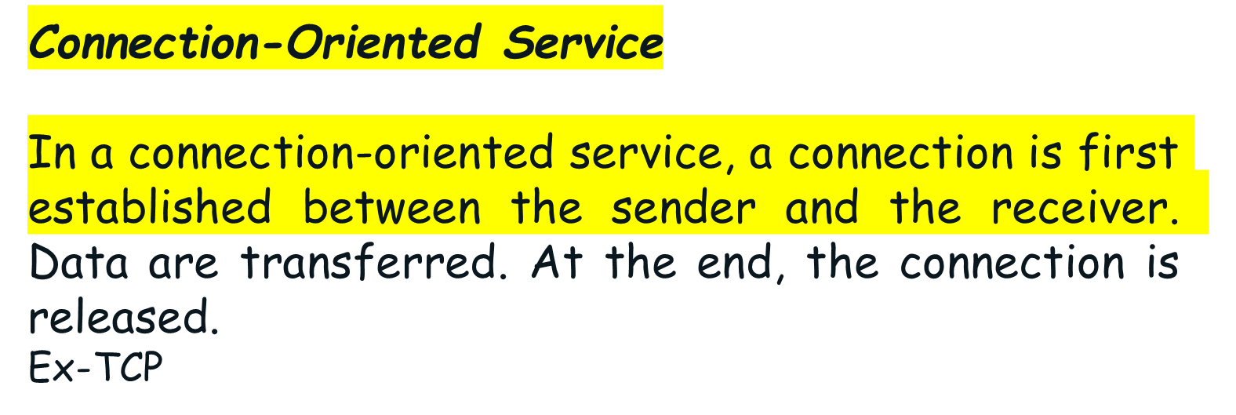
Cont.

Slide 19
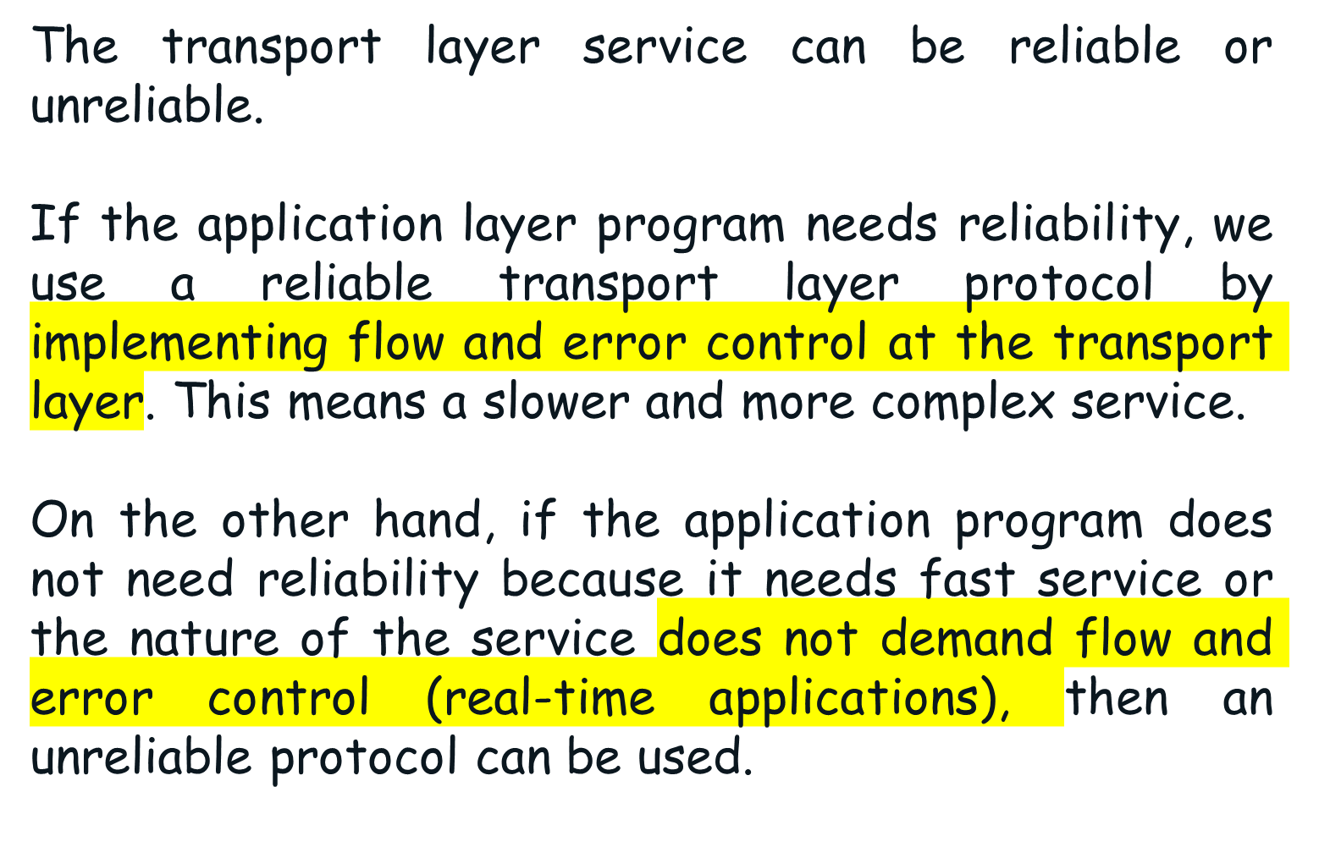
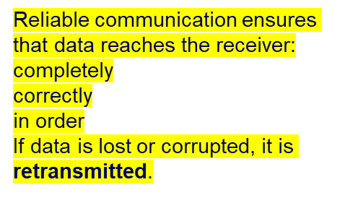
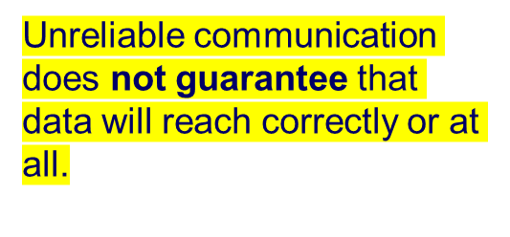
Reliable Versus Unreliable

Slide 20
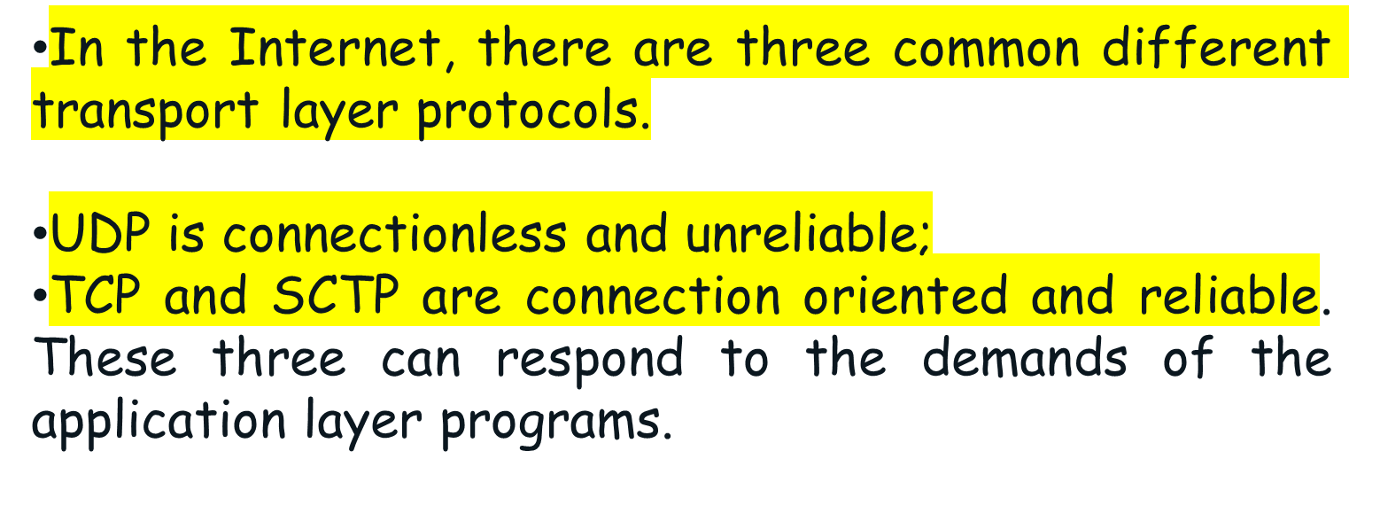
Cont.

Slide 21
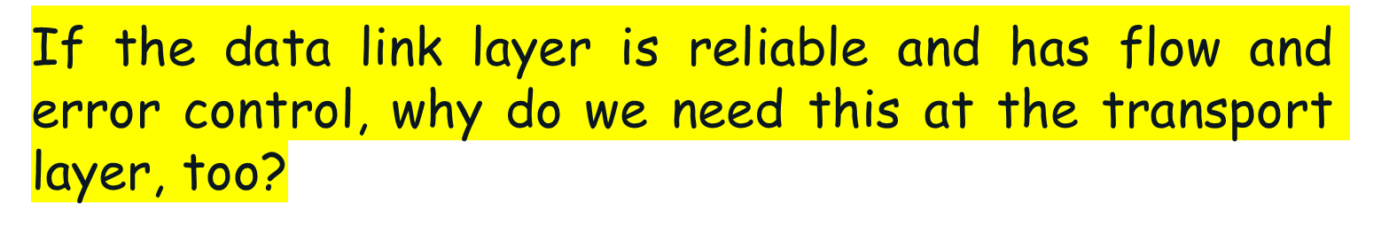
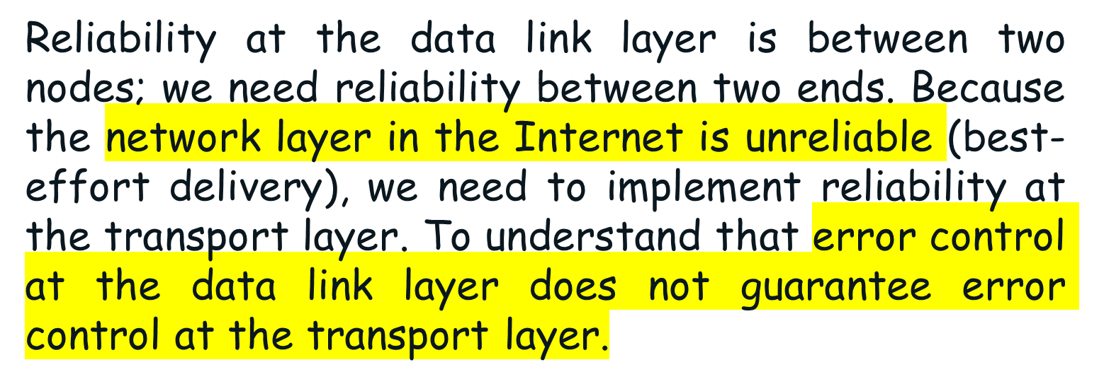
Question
Answer

Slide 22
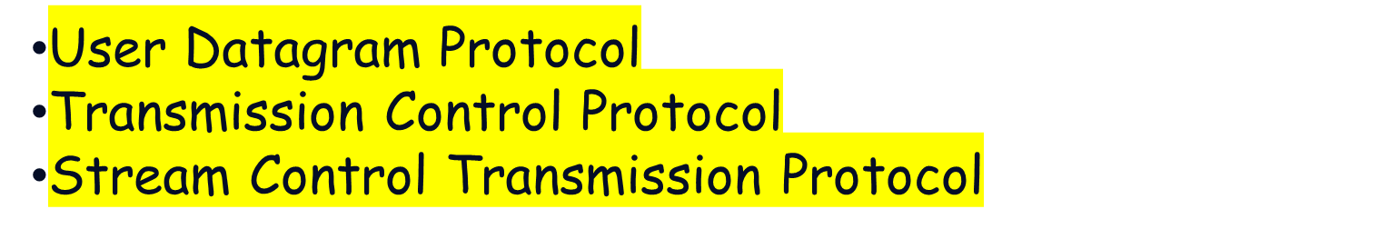


Slide 23
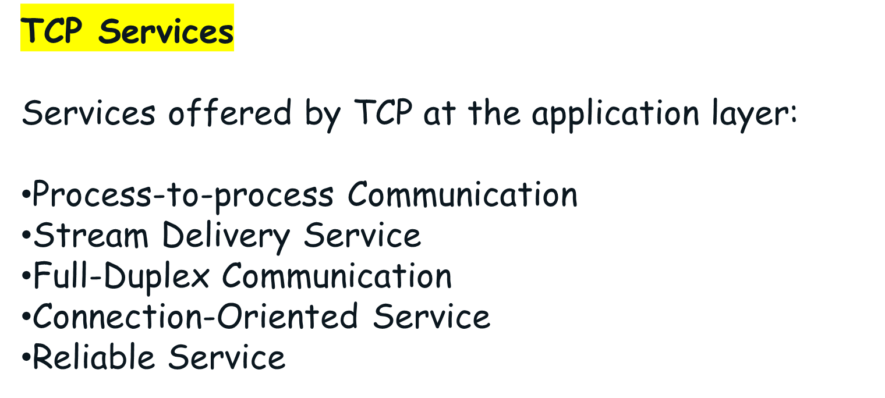

TCP and UDP protocols, establishing a TCP connection

Slide 24
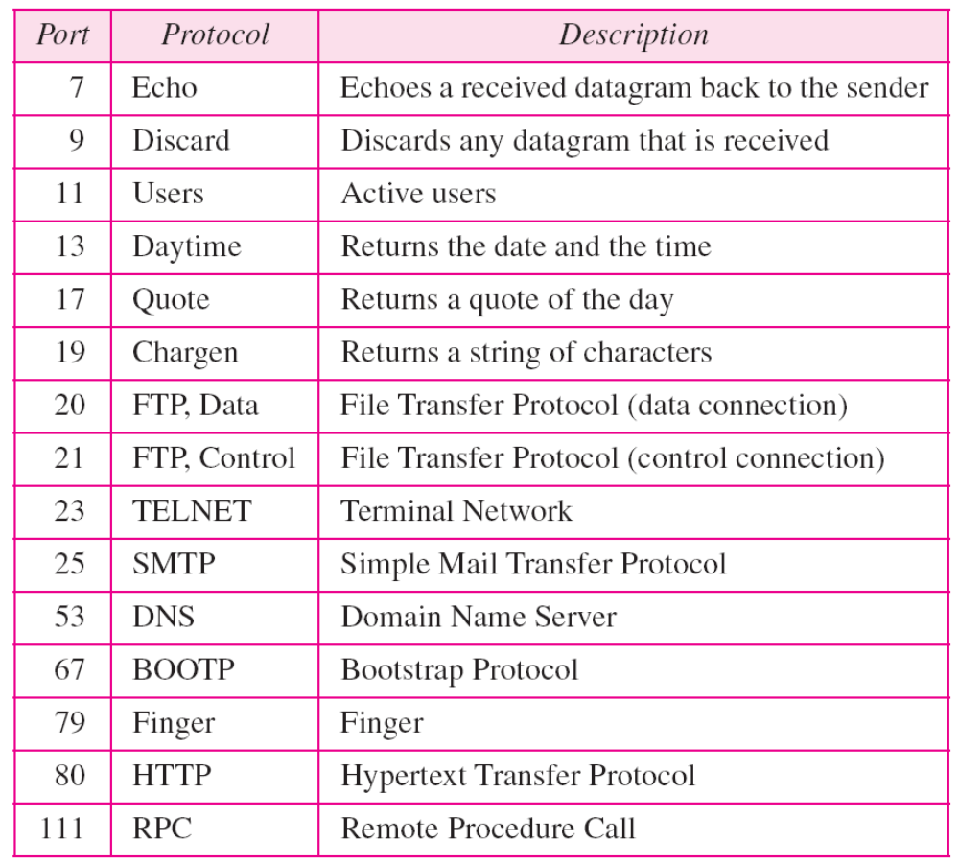
Well-known ports used by TCP

Slide 25
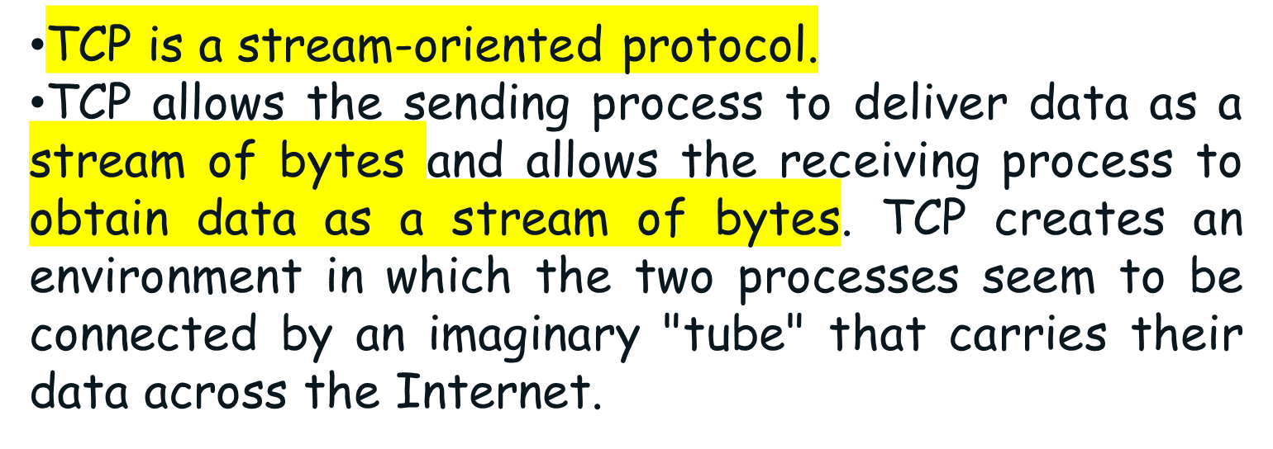

Stream Delivery Service

Slide 26

Sending and receiving buffers
Because the sending and the receiving processes may not write or read data at the same speed, TCP needs buffers for storage.
There are two buffers, the sending buffer and the receiving buffer, one for each direction.
One way to implement a buffer is to use a circular array of 1-byte locations as shown in above figure.

Slide 27
Cont.
At the sending site, the buffer has three types of chambers.
The white section contains empty chambers that can be filled by the sending process (producer).
The gray area holds bytes that have been sent but not yet acknowledged. TCP keeps these bytes in the buffer until it receives an acknowledgment.
The colored area contains bytes to be sent by the sending TCP.
Note:
After the bytes in the gray chambers are acknowledged, the chambers are recycled and available for use by the sending process.

Slide 28
Cont.
At the receiving site the circular buffer is divided into two areas (shown as white and colored).
The white area contains empty chambers to be filled by bytes received from the network.
The colored sections contain received bytes that can be read by the receiving process.
When a byte is read by the receiving process, the chamber is recycled and added to the pool of empty chambers.

Slide 29

TCP segments
At the transport layer, TCP groups a number of bytes together into a packet called a segment.
TCP adds a header to each segment (for control purposes) and delivers the segment to the IP layer for transmission.
The segments are encapsulated in IP datagrams and transmitted. This entire operation is transparent to the receiving process.

Slide 30

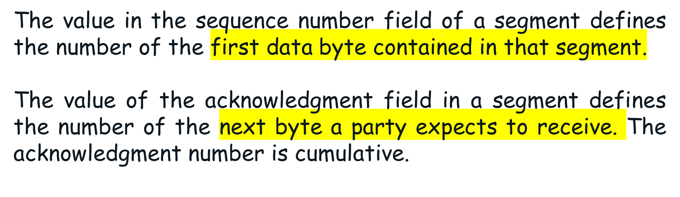
Suppose a TCP connection is transferring a file of 5000 bytes. The first byte is numbered 10,00l. What are the sequence numbers for each segment if data are sent in five segments, each carrying 1000 bytes?
Solution
The following shows the sequence number for each segment:

Slide 31


Slide 32



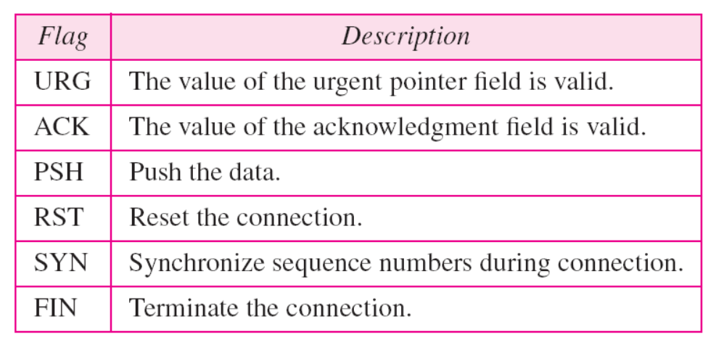
These bits enable flow control, connection establishment and termination, connection abortion, and the mode of data transfer in TCP.

Slide 33
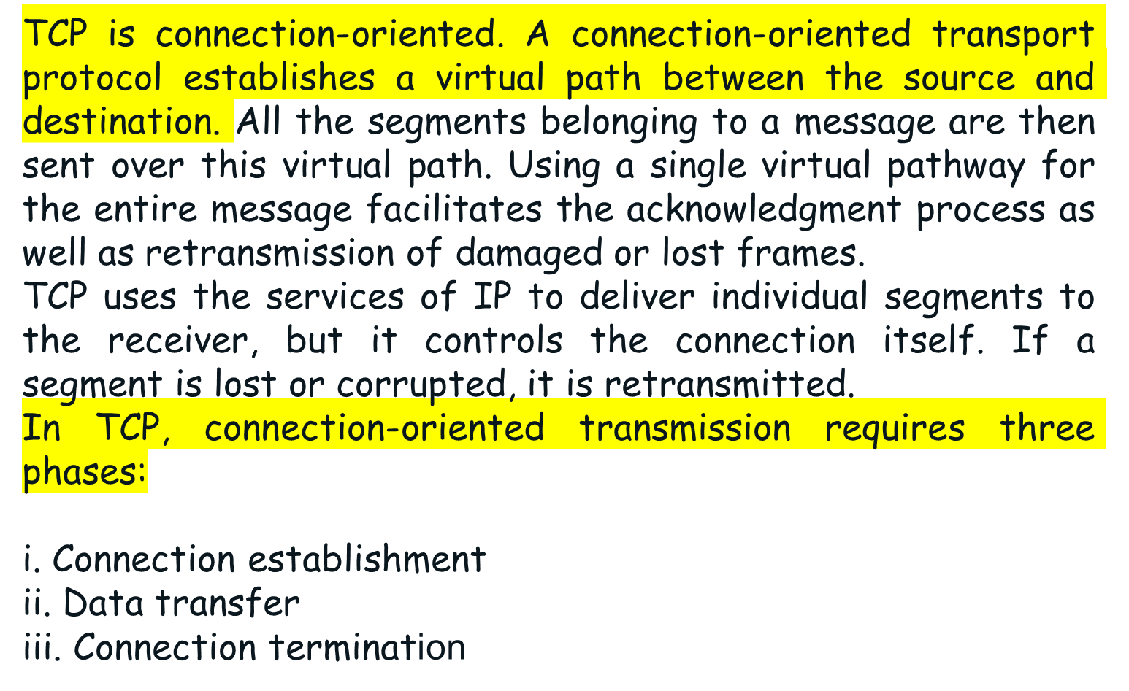


Slide 34
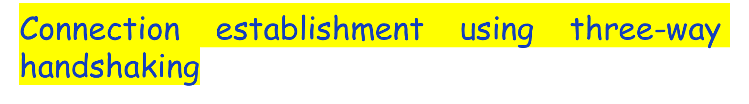
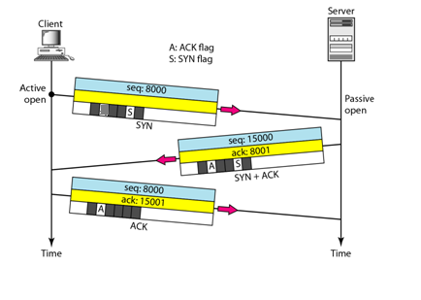
The client sends the first segment, a SYN segment, in which only the SYN flag is set. This segment is for synchronization of sequence numbers. It consumes one sequence number. When the data transfer starts, the sequence number is incremented by 1.

Slide 35
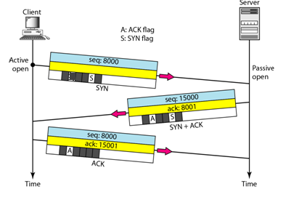
Cont.
The server sends the second segment, a SYN + ACK segment, with 2 flag bits set: SYN and ACK. This segment has a dual purpose. It is a SYN segment for communication in the other direction and serves as the acknowledgment for the SYN segment. It consumes one sequence number.

Slide 36
Cont.
The client sends the third segment. This is just an ACK segment. It acknowledges the receipt of the second segment with the ACK flag and acknowledgment number field. Note that the sequence number in this segment is the same as the one in the SYN segment; the ACK segment does not consume any sequence numbers.

Slide 37

Data Transfer
After connection is established, bidirectional data transfer can take place. The client and server can both send data and acknowledgments.
In this example, after connection is established the client sends 1000 bytes of data in two segments. The
The server then sends 2000 bytes in one segment. The client sends one more segment. The first three segments carry both data and acknowledgment, but the last segment carries only an acknowledgment because there are no more data to be sent..

Slide 38
Connection Termination
Any of the two parties involved in exchanging data (client or server) can close the connection, although it is usually initiated by the client. Most implementations today allow two options for connection termination: three-way handshaking and four-way handshaking with a half-close option.
Three-Way Handshaking
Most implementations today allow three-way handshaking for connection termination as shown in next Figure.

Slide 39

Cont.
In a normal situation, the client TCP, after receiving a close command from the client process, sends the first segment, a FIN segment in which the FIN flag is set.
Note:
If FIN segment can include the last chunk of data sent by the client, or it can be just a control segment as shown in Figure. If it is only a control segment, it consumes only one sequence number.

Slide 40
Cont.
The server TCP, after receiving the FIN segment, informs its process of the situation and sends the second segment, a FIN +ACK segment, to confirm the receipt of the FIN segment from the client and at the same time to announce the closing of the connection in the other direction.
This segment can also contain the last chunk of data from the server. If it does not carry data, it consumes only one sequence number.

Slide 41
Cont.
The client TCP sends the last segment, an ACK segment, to confirm the receipt of the FIN segment from the TCP server.
This segment contains the acknowledgment number, which is 1 plus the sequence number received in the FIN segment from the server. This segment cannot carry data and consumes no sequence numbers

